Slide 1

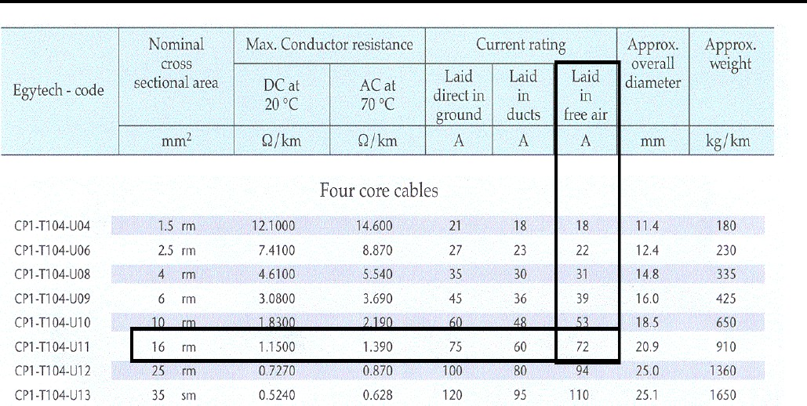
DR. Raghad Ali Aljourni Power System Distribution
Example
An electric panel board design is required to operate three motors 30 hp as well as two motors A 23 hp , calculate the size of cables.

Slide 2

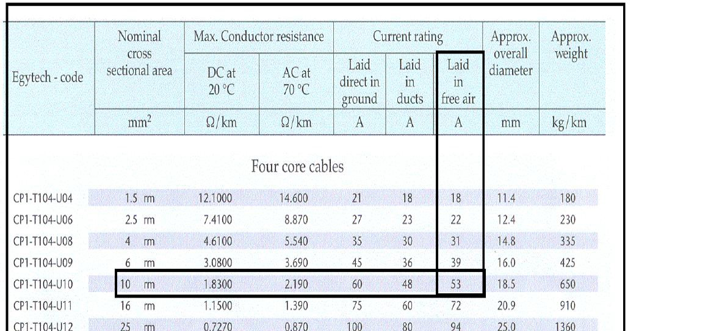
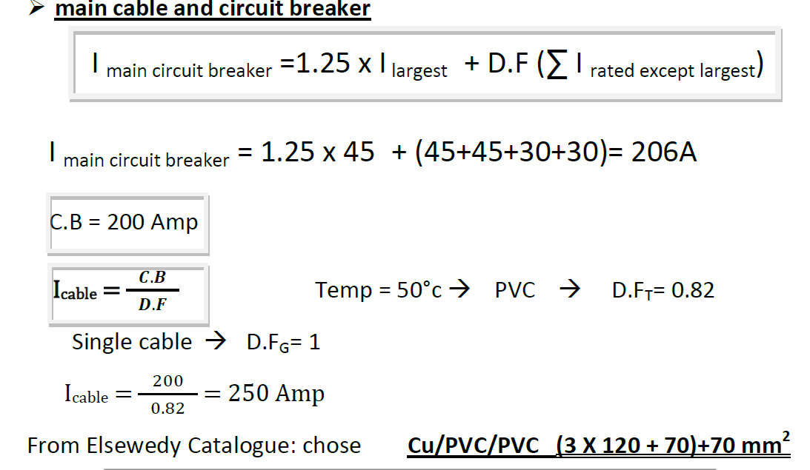

Slide 3
